Slide 1

Capstone Project - The Battle of Neighborhoods
Scarborough, Toronto
August
2020

Slide 2

About the project
The goal of this project is to help people explore better facilities around them. This will help people make a smart and effective decision in choosing a great neighborhood from several other neighborhoods in Scarborough, Toronto.
Many people migrate to Canada and need a lot of research on good housing prices and venues in Scarborough.
The goal of this project is to create an analysis of features for people migrating to Scarborough and find the best neighborhood for them.

Slide 3
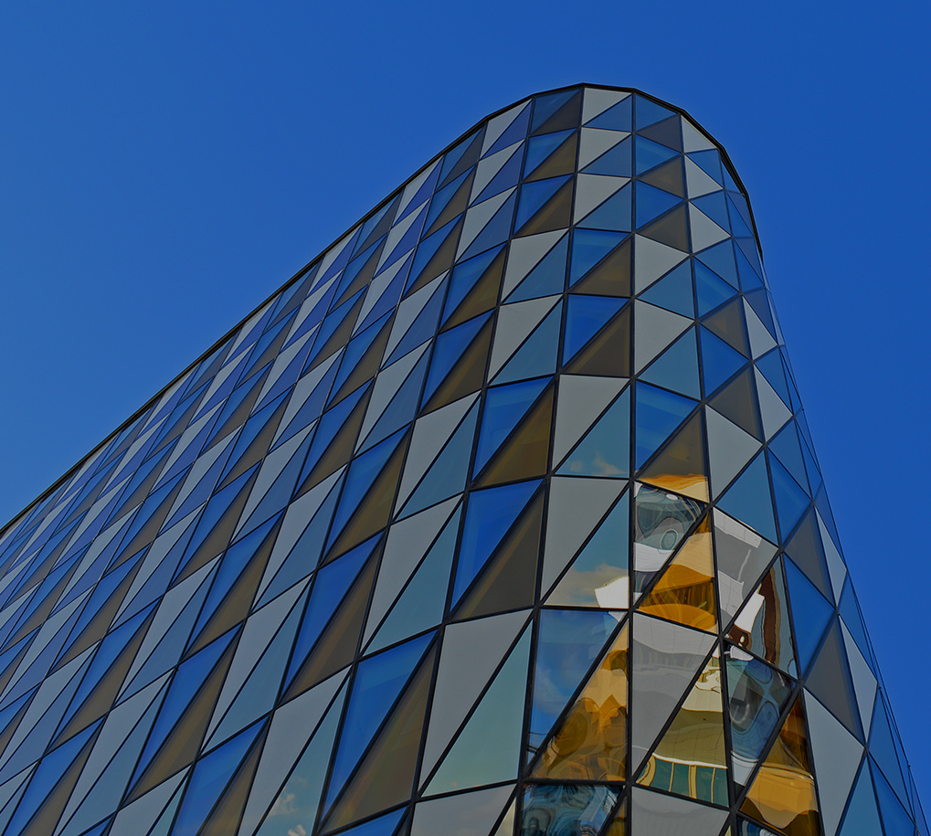
The Problem
The main goal of this project is to help people who want to migrate to Scarborough to learn about the neighborhoods in the borough and find the most suitable one for them (considering the venues and house prices).

Slide 4
About the location
Scarborough is an administrative division of Toronto, Ontario, Canada. Situated atop the Scarborough Bluffs, it occupies the eastern part of the city. Scarborough is contained within the borders of Victoria Park Avenue on the west, Steeles Avenue to the north, Rouge River and the city of Pickering to the east, and Lake Ontario to the south. It borders Old Toronto, East York and North York in the west and the city of Markham in the north. Scarborough was named after the English town of Scarborough, North Yorkshire.

Slide 5
The Data
We will use the data set we retrieved from Wikipedia in week 3. The data set contains latitude and longitude, and zip codes.
We will need data about different venues in different neighborhoods of that specific borough. In order to gain that information we will use "Foursquare" locational information. Foursquare is a location data provider with information about all manner of venues and events within an area of interest. Such information includes venue names, locations, menus and even photos. As such, the foursquare location platform will be used as the sole data source since all the stated required information can be obtained through the API.
After finding the list of neighborhoods, we then connect to the Foursquare API to gather information about venues inside each neighborhood. For each neighborhood, we have chosen the radius to be 100 meter.

Slide 6
Methodology
To compare the similarities of the neighborhoods, we need to segment them, and group them into clusters.
Clustering Approach
To compare the similarities of two cities, we decided to explore neighborhoods, segment them, and group them into clusters to find similar neighborhoods in a big city like New York and Toronto. To be able to do that, we need to cluster data which is a form of unsupervised machine learning: k-means clustering algorithm.
Foursquare API
This project would use Four-square API as its prime data gathering source as it has a database of millions of places, especially their places API which provides the ability to perform location search, location sharing and details about a business.
Using credentials of Foursquare API features of near-by places of the neighborhoods would be mined. Due to http request limitations the number of places per neighborhood parameter would reasonably be set to 100 and the radius parameter would be set to 500.

Slide 7
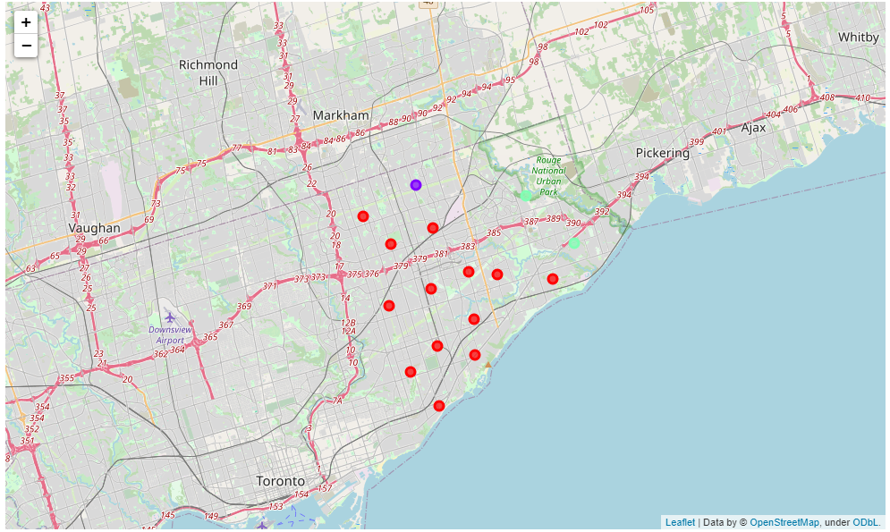
The Clusters

Slide 8
Conclusion
Considering the results, I think anyone who intends to move to Scarborough should think about what venues interest him and are important to him. He will then be able to check by proximity to attractions and by average price in the area, thus making it easier for him to focus his search for an apartment.
Everyone will make their own weighting of location and amount of money that he is willing to invest in the house.

Slide 9

THANK YOU!

